Slide 1
Machine Learning Supervised Learning K- Nearest Neighbors (KNN) Classifier
Instructor: Zainab Yousuf

Slide 2
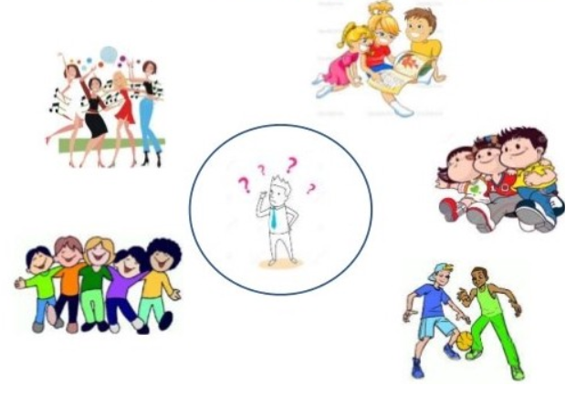
Simple Analogy of KNN Classifier
Tell me your friends (who your neighbors are) and I will tell you who you are:

Slide 3
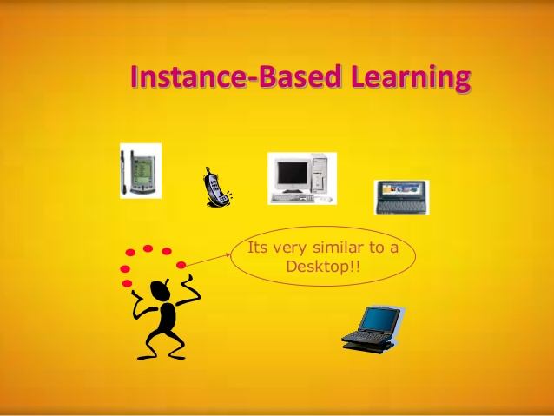
Notes:
In machine learning, instance-based learning (memory-based learning) is a family of learning algorithms that, instead of performing explicit generalization, compares new problem instances with instances seen in training, which have been stored in memory.

Slide 4
Intro to KNN Classifier
The k-nearest neighbors (KNN) algorithm is a simple, easy-to-implement supervised machine learning algorithm.
K-nearest neighbors (KNN) algorithm is a type of supervised ML algorithm which can be used for both classification as well as regression predictive problems. However, it is mainly used for classification predictive problems in industry. The following two properties would define KNN well −
Lazy learning algorithm − KNN is a lazy learning algorithm because it does not have a specialized training phase and uses all the data for training while classification.
Non-parametric learning algorithm − KNN is also a non-parametric learning algorithm because it doesn’t assume anything about the underlying data.
K-nearest neighbors (KNN) algorithm uses ‘feature similarity’ to predict the values of new datapoints which further means that the new data point will be assigned a value based on how closely it matches the points in the training set.

Slide 5
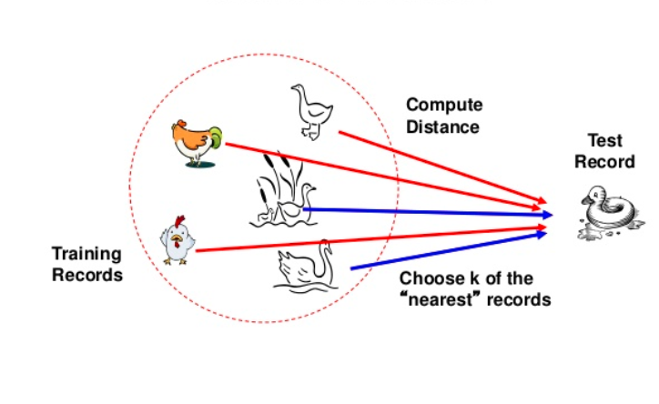
Working of KNN classifier
We can understand its working with the help of following steps −
Step 1 − For implementing any algorithm, we need dataset. So during the first step of KNN, we must load the training as well as test data.
Step 2 − Next, we need to choose the value of K i.e. the nearest data points. K can be any integer.
Step 3 − For each point in the test data do the following −
3.1 − Calculate the distance between test data and each row of training data with the help of any of the method namely: Euclidean, Manhattan or Hamming distance. The most commonly used method to calculate distance is Euclidean.
3.2 − Now, based on the distance value, sort them in ascending order.
3.3 − Next, it will choose the top K rows from the sorted array.
3.4 − Now, it will assign a class to the test point based on most frequent class of these rows.
Step 4 − End

Slide 6
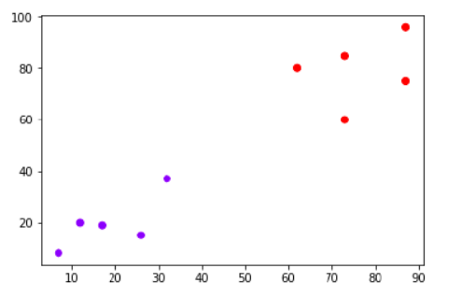
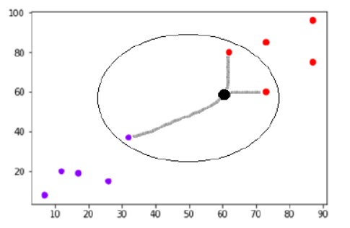
Working of KNN classifier
Suppose we have a dataset which can be plotted as follows:
Now, we need to classify new data point with black dot (at point 60,60) into blue or red class. We are assuming K = 3 i.e. it would find three nearest data points as shown below:
We can see in the above diagram the three nearest neighbors of the data point with black dot. Among those three, two of them lies in Red class hence the black dot will also be assigned in red class.

Slide 7
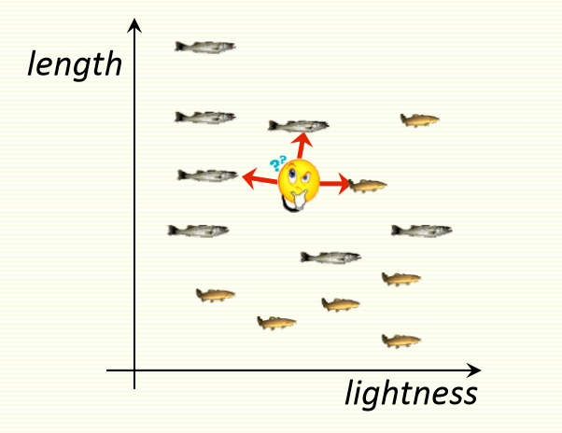
Example Classify the fish to Sea Bass or Salmon
classify an unknown example with the most common class among k closest examples
k= 3
2 fish species(class): sea bass and salmon
2 features: lightness and length
For k=3, 2 sea bass, 1 salmon are NN
Thus, classify as sea bass

Slide 8
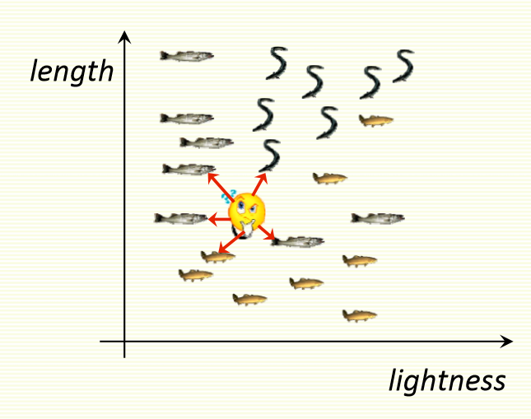
Example Classify the fish to Sea Bass or Salmon- Multi Class
Easy to implement for multiple classes
k= 5
3 fish species(class): salmon, sea bass, and eel
2 features: lightness and length
For k=5, 3 sea bass, 1 eel, 1 salmon are NN
Thus, classify as sea bass

Slide 9
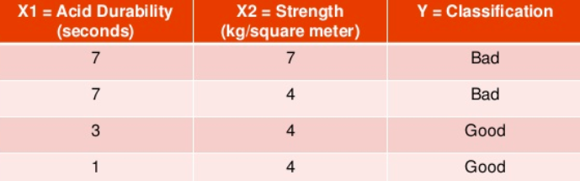
Example
We have data from the questionnaires survey and objective testing with two features (acid durability and strength) to classify whether a special paper tissue is good or not. Following are the four training samples:

Slide 10
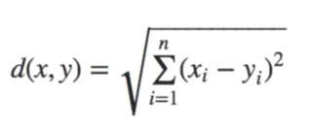

Example (Cont.…)
Step 1: Initialize and define k
Lets say k=3, (always choose k as an odd number to avoid the tie in the class prediction)
Step 2: Compute the distance between test sample and training samples
Let’s say the test sample is (3,7)
Several distance formulas can be used:
Euclidean distance:
Squared Euclidean distance: The Euclidean Squared distance metric uses the same equation as the Euclidean distance metric, but does not take the square root.
Manhattan Distance:

Slide 11
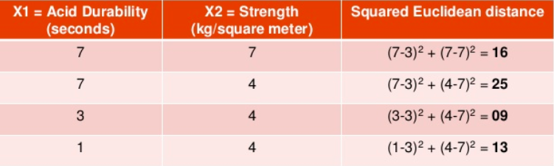
Step 2:
Calculating the distance of test sample (3,7) with all the training samples of the dataset shown on slide 9.
Squared Euclidean distance formula is used as follows:

Slide 12
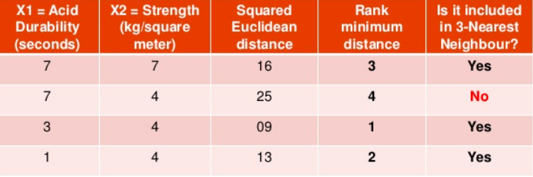
Example (Cont.…)
Step 3:
Sort the distance and determine the nearest neighbors (k=3 we need 3 nearest neighbors)

Slide 13
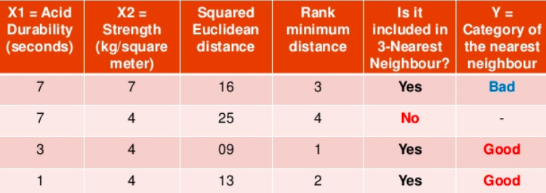
Example (Cont.…)
Step 4:
Take 3 nearest neighbors as the value of k=3
Check the class label (Y) of the three nearest neighbors

Slide 14
Example (Cont.…)
Step 5:
Apply simple majority
We have 2 Good and 1 Bad.
Thus we can conclude that the new paper tissue that passes the laboratory test with x1= 3 and x2= 7 is included in the “Good” category.

Slide 15
Thank You

Slide 16
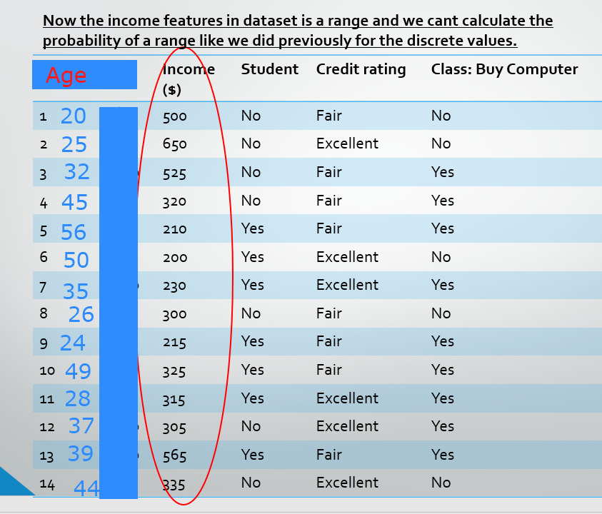

Slide 17
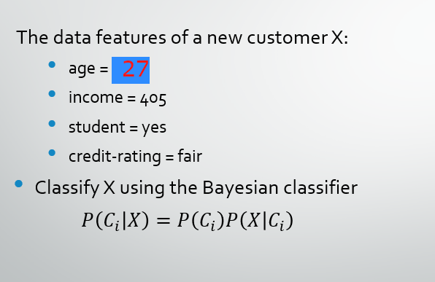

Slide 18
Simple explanation of Supervised Learning
A supervised machine learning algorithm (as opposed to an unsupervised machine learning algorithm) is one that relies on labelled input data to learn a function that produces an appropriate output when given new unlabelled data.
Imagine a computer is a child, we are its supervisor (e.g. parent, guardian, or teacher), and we want the child (computer) to learn what a dog looks like. We will show the child several different pictures, some of which are dogs and the rest could be pictures of anything (cats, tigers, etc).
When we see a dog, we shout “dog!” When it’s not a dog, we shout “no, not dog!” After doing this several times with the child, we show them a picture and ask “dog?” and they will correctly (most of the time) say “dog!” or “no, not dog!” depending on what the picture is. That is supervised machine learning.

Slide 19
Simple explanation of Supervised Learning
A classification problem has a discrete value as its output. For example, “likes pineapple on pizza” and “does not like pineapple on pizza” are discrete. There is no middle ground. The analogy on previous slide of teaching a child to identify a dog is another example of a classification problem.
A regression problem has a real number (a number with a decimal point) as its output. For example, we could use the data of individuals to estimate someone’s weight given their height.

